Slide 1
MALE CHAMPIONS FOR GENDER EQUALITY
swpglobal.org

Slide 2
To change attitudes and gender stereotypes both men and women need to be involved.
Notes:
Many companies understand the relationship between gender equality and increased innovation and profitability. They have an ambition to increase gender equality and carry out activities to empower women in the workplace. The problem is that gender equality mainly has become a woman’s issue. To change attitudes and gender stereotypes both men and women need to be involved.

Slide 3
Persisting patriarchal attitudes and normative stereotypes regarding gender roles is negative for Vietnam’s future development.
Notes:
Vietnam has one of the highest female labour-force participation rates in the world and has a relatively high proportion females in management positions compared to other Asian countries. However, patriarchal attitudes and normative stereotypes regarding gender roles and responsibilities persist. Gender bias is confining Vietnamese women to caregiving roles, stopping them from considering different types of work and from advancing professionally. The UN Committee on the Elimination of Discrimination against Women (CEDAW) has stated that the presence of such bias in media, education and its perpetuation in the nation’s consciousness would have far-reaching consequences for Vietnam’s future.

Slide 4
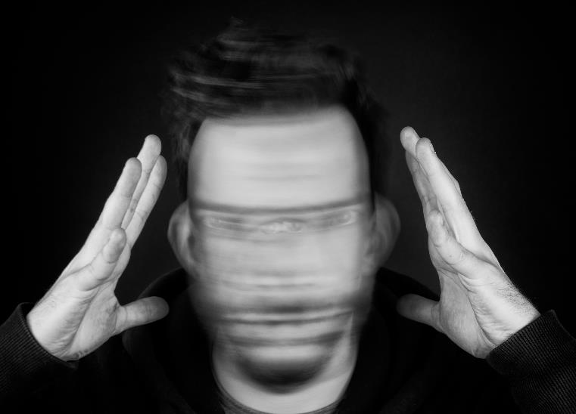
Men are currently facing some mental health issues, and one of the most alarming ones found is the pressure related to work and their role as the ‘family’s pillar’. According to national statistics, the rate of suicide in men is higher than that in women and has continued to rise in recent years.
Men and masculinities in a globalising Viet Nam, 2020
Notes:
The prevalent gender norms could also be a burden for men. In the study “Men and masculinities in a globalising Viet Nam, 2020”, men state that they feel pressure related to work and their role as the ‘family’s pillar’.

Slide 5
Are you ready to talk and discuss?
Notes:
Sau khi đã chia sẻ 3 câu chuyện về việc đàn ông cần phải lên tiếng.

Slide 6
GROUP DISCUSSION
Read the guidelines.
Appoint a person to lead the conversation and make sure everyone gets the chance to speak.
Use the questions in the conversation guide. You don’t need to have a specific order to the questions. Just choose questions that interest you.
No one needs to ‘perform’. The point isn’t to show off your knowledge but rather to open up, both to others’ stories and by sharing your own.
No recording or note-taking .
Anything shared in the group stays in the group.

Slide 7
HOW WAS IT?
• How did it feel to speak about these topics?
• Did something feel difficult or uncomfortable?
• What will you take with you from this experience – and is this something you would consider doing again?
• Have you learned anything about yourself during the conversation? (Share, if you feel comfortable doing so)
• Are there any concrete changes you want to make in your life that you discovered during the conversation? Remind each other that everything said during the conversation stays in the group!

